Slide 1

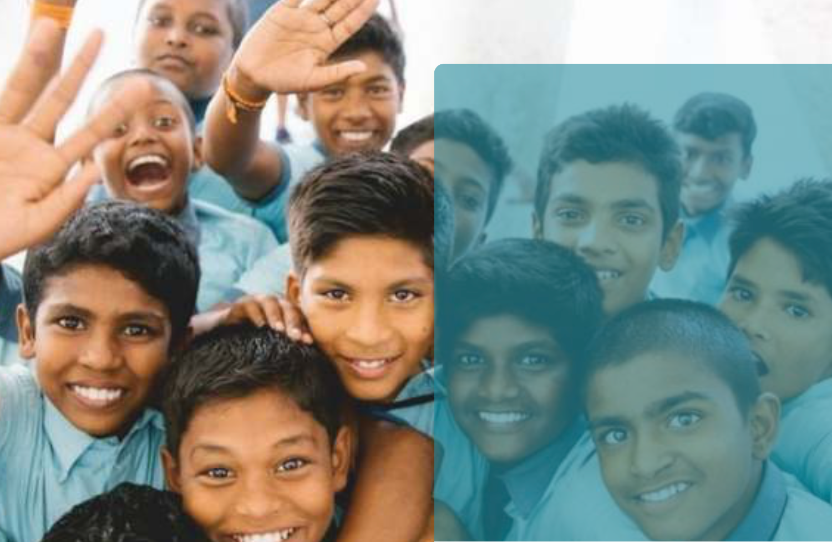

Advertisement Campaign Creation for
Our Mitti Foundation
GROUP 13
Arnika Bansal- 2025PGDM009
Chinnari Sai Abhishek -2025PBDI011
Deepali Verma -2025PGDM135
Kashish Kapoor -2025PGDM081
Sananda Sharangi -2025PGDM038
Shreya Agarwal- 2025PBDI033

Slide 2

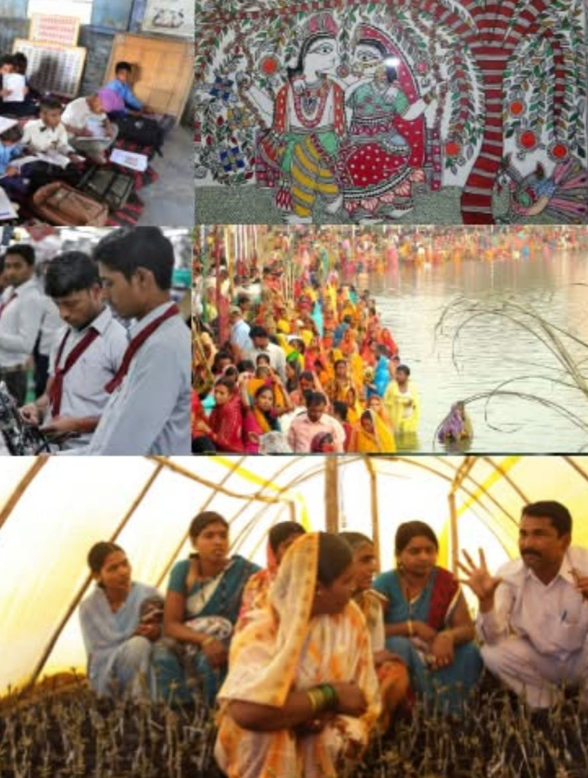


Introduction
Our MITTI Foundation is an NGO committed to preserving cultural heritage and driving positive change in rural communities through education and entrepreneurship. Operating transparently as a trust, the foundation embodies its tagline, "Samman Aapki Pahchan Ka," to create meaningful social impact.
Key Objectives:
  Education: Adopt a School
  Entrepreneurship: School of Entrepreneurship
  Cultural Revival: Reconnecting youth with heritage through workshops, festivals, and traditional experiences

Slide 3

Our Mitti Foundation Overview
Mission and Vision-
“To promote and preserve cultural and traditional identity. To bring change in the rural society via education and entrepreneurship.’’
Key leaders include Pramod Kumar Suman, an award-winning journalist, and Chandan Kumar, a visionary entrepreneur.
Significant Achievements:
Revived traditional values via workshops, festivals, and cultural programs, fostering deeper community connections.
Improved infrastructure and modern teaching methods in rural schools, targeting 100 schools by 2025.
Empowered over 2,000 youth through skill development and entrepreneurial training.

Slide 4
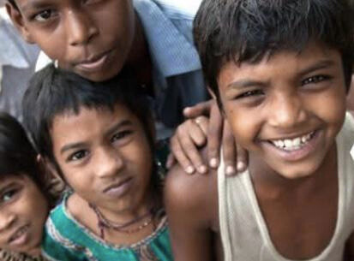

Challenges
  Limited Resources
  Community Engagement
  Staffing and Volunteer Management
  Monitoring and Evaluation

Slide 5


Advertising Objective
Primary Goal:
Increase brand awareness of Our Mitti Foundation among residents of Delhi NCR to encourage greater engagement, donations, and volunteer participation.

Slide 6




Defining the Target Audience
Demographics:
  Age: 18-45 years
  Gender: All
  Occupation: Students, professionals, and families with disposable income or interest in social/cultural causes
  Income: Middle to upper-middle class
Psychographics:
  Interests: Community service, cultural heritage, education, environmental sustainability
  Lifestyle: Socially conscious individuals actively supporting NGOs or seeking ways to make a social impact
Geographics
  Region: Urban and peri-urban areas of Delhi NCR
  Key Localities: Dwarka, Gurugram, Noida, South Delhi

Slide 7
Consumer Insights
  Used to feel disconnected from rural communities and traditions
  Value transparency and tangible impact
  Seek meaningful, value-driven activities

Slide 8

Crafting the Message Theme
Core Idea:
“Our Mitti Foundation bridges the gap between tradition and modernity, empowering rural communities while preserving India’s cultural heritage.”
Key Messages:
    “Be a part of the change that empowers and educates rural India.”
    “Rediscover and preserve our shared heritage.”
Tone: Inspirational, relatable, and community-focused.

Slide 9



Facts that suabstantiate the message theme
Proven success in projects like “Adopt a School” and “Enabling Youth to Work.”
Support
Recognition by international bodies and partnerships with credible organizations.
Testimonials from beneficiaries and event photos/videos showcasing the foundation’s impact.

Slide 10



Constraints/Mandatories
We include the tagline: "Samman Aapki Pahchan Ka."
Ensure all visual materials adhere to the foundation’s branding guidelines (logo, colors, fonts).
Include a call-to-action for donations, volunteering, or event participation.

Slide 11
Digital Platforms:
1
Medium for the Campaign
  Instagram, Facebook, LinkedIn, and YouTube for storytelling and engagement.
  Google Ads targeting Delhi NCR for visibility.
2
Local Media:
Posters and banners at key public spaces, such as metro stations and malls.
3
Events:
  Collaborations with colleges and cultural organizations for workshops and awareness programs.
  Live storytelling sessions and exhibitions showcasing rural artistry.

Slide 12
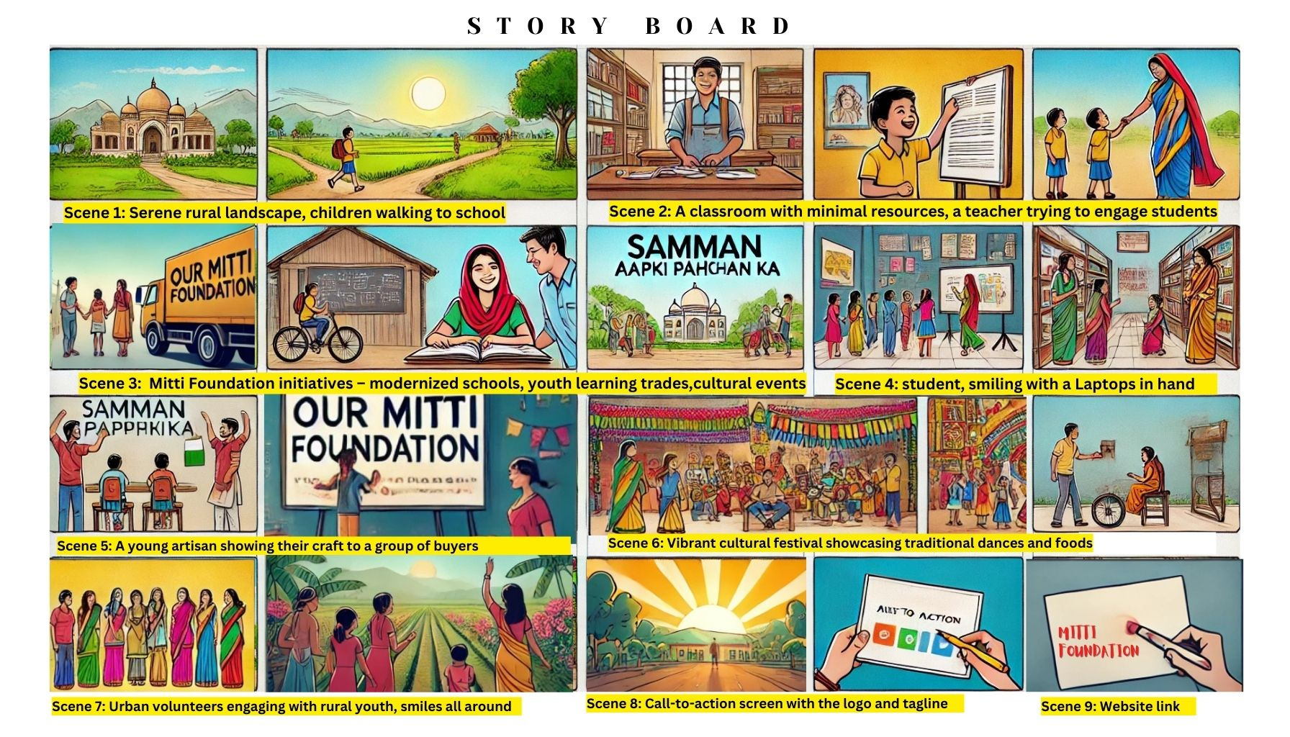

Slide 13
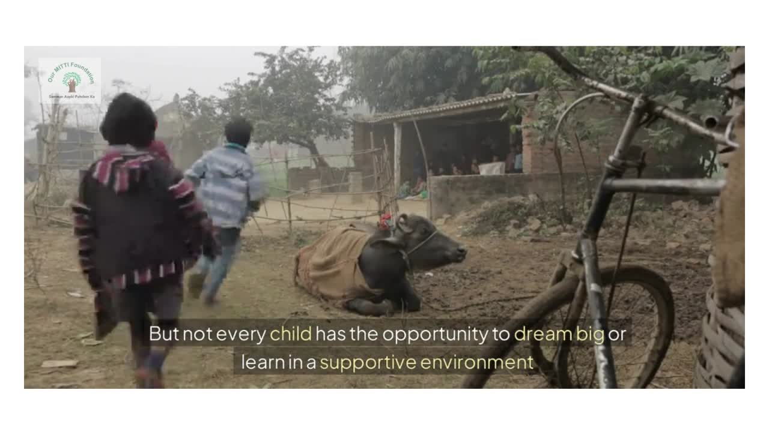
Project Output- The Ad Video

Slide 14

THANK YOU!

